Slide 1

Introduction to File I/O
Notes:
Welcome back, everyone! You know all those python programs that you wrote and saved onto your computer’s hard disk? Those programs are actually stored in what is known as a file, and the cool thing about files is that after you switch off your computer and turn it back on, everything you wrote is still there.
Files can store all kinds of information, from python programs and PowerPoint presentations to sound clips and movies. In this lesson, we will discover how python programs can both read from and write to a file, so that you can do lots of nifty stuff. This is known as file input/output, but all the cool kids call it “File I/O” for short.

Slide 2
Objectives
At the end of this lecture, you will …
Be able to read and write text files
Built-in open() function in Python
More on files will be covered in a later lesson
Notes:
In this lesson, we will only be covering some of the basics of file I/O, which should be enough to get you started with your weekly activities and Coursemology exercises. We will focus primarily on text files, which are files that contain characters. Specifically, we will show how you can access a text file using the open() function, so that you can read text from it and write text to it. There will be a more complete lesson on files later in the course.

Slide 3
File Type
A file is categorized as either text or binary, and the difference between the two file types is important
Text files
Structured as a sequence of lines, where each line includes a sequence of characters
Each line is terminated with a special character, called the EOL or End of Line character
Binary files
Consists of a sequence of bytes
Can only be processed by an application that understands the file’s structure
Notes:
A file is either a text file or a binary file depending on the information that it contains.
Text files contains lines of text, and are usually human-readable, so you could open a text file with a text editor like Notepad and be able to read and understand what it says. Each line consists of a sequence of characters, which could be letters, numbers, symbols or certain special characters. And at the end of each line, there is usually an end-of-line (or EOL) character to signify the end of the line. If this is all a file contains, it’s a text file.
A binary file is essentially a non-text file. Instead of containing human-readable characters, it contains a sequence of bytes, which is essentially a binary code made of a bunch of ones and zeros. In general, you can’t just open a binary file with a text editor to see what the file contains. Instead, you need some specialized program that understands the file’s structure to make sense of the information. For example, image files are binary files stored in a specific format, such as jpg or bmp. If you open an image file with a text editor, it won’t work. To see the image, you will need a special program such as MS Paint that can understand the file format in order to display the image.

Slide 4
Create a Text File
Create a text file called todolist.txt using Notepad that contains the following text:
Save the file in a known directory, e.g., d:\PRG1_data\todolist.txt
To do:
- Read lecture slides
- Do mini quiz
- Upload python file
Notes:
To see how Python handles files, let’s first create a text file using Notepad. Just open Notepad and type in the following text.
Now save the file in some directory. For example, you could create a directory in D drive called PRG1_data and save the file as todolist.txt. In that case, the full pathname of the file would be as given here. If you did this correctly, you should be able to use Windows Explorer to open the PRG1_data folder in D drive and see the todolist.txt file right there.

Slide 5
File I/O
open function is a Python built-in function that returns a file object.
File objects contain methods and attributes that can be used to collect information about the file and can be used to manipulate the file.
Notes:
OK, now let’s see how python handles files, specifically text files.
The first thing that we need to do is to have something that tells the program which file we are trying to access. For this purpose, python has the built-in function called open(), which returns a file object. The file object provides a bunch of useful functions that we can use to manipulate the file. Let’s see how this works.

Slide 6
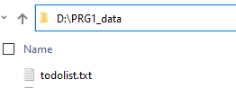
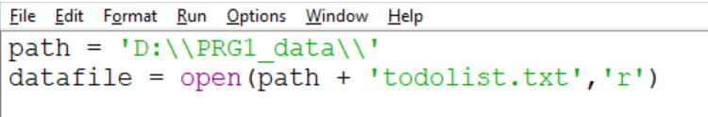
open() function
Usage file_object = open("filename", "mode")
The modes are (not exhaustive):
'r' – Read mode - used when the file is only being read
'w' – Write mode - used to edit and write new information to the file
(any existing files with the same name will be erased when this mode is activated)
'a’ – Append mode - used to add new data to the end of the file; the old data is not removed
Example, to read a file todolist.txt
Replace with the your own path directory. Use ‘\\’
Notes:
The open function takes in two parameters, both of which are strings. The first parameter is the name of the file to open, while the second parameter is the mode of operation. Assuming nothing goes wrong, the open function will return a file object, which you can assign to a variable as usual.
The filename is pretty straightforward: it’s just the name of the file. If the file is in the same directory as the python program file, then you just need to provide the filename, but if it is in some other directory, you will need to give the full pathname.
The second parameter is the mode, which describes what you are going to do with the file. There are several available modes, but at this point we will look at the three most common ones. Read mode, represented by the letter r, is used when you only want to read the file without changing its contents. Write mode, denoted by w, is used when you want to write to a file, and any existing file with the same name will be erased. However, if you do not wish to erase the existing file but want to add on to the file, then you should instead use append mode, represented by the letter a. In this mode, anything you write will be added to the end of the existing file.
For example, suppose you have a file called “todolist.txt” that you created using notepad, and you want to read this file. Here is what you might do. If the file is not in the same directory as the python program file, you will need to provide the full path. One common practice is to have a separate string variable that contains the path, in this case it’s D double backslash PRg1_data double backslash. Why double backslash? Remember when we were talking about escape characters for strings? Well, the escape character for the backslash character is two backslash characters. Crazy, I know. Anyway, with the path variable properly initialized, we can use path + “todolist.txt” to create the full pathname for the file as the first argument to the open function. Since we want to read the file, the second argument is “r” for read mode. Finally, we assign the result of the function to our variable datafile.

Slide 7
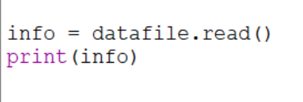
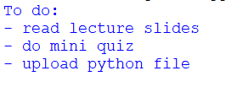
Reading Text from a File
Read the text file and display the contents
Ways to read a text file in Python
file.read() - extract a string that contains all characters in the file.
file.read(5) - read the next five characters of stored data and return it as a string.
file.readline() - return the next line of the file
Notes:
OK, we’ve obtained the file object. What can we do with it? Quite a lot, actually, but for now, let’s just see how we can read text from the file. Given the file object called datafile, we can use the read function to grab the entire file and return it as a single gigantic string. To verify that the text has been read, just print the string to see the output.
Instead of reading the entire file at once, you could specify the number of characters to extract, so file.read(5) would read and return the next five characters from the file as a string. You could also use readline() to return the next line of the file. Note that the file object keeps track of the position of the file that was last read, so if you call readline several times, each call will return the next line.

Slide 8
Activity Break!
Try to work on activity 9 now…
Remember to submit your solution to POLITEMall when you have completed all of them
Notes:
Music from https://www.fiftysounds.com/royalty-free-music/marseille.html

Slide 9
Summary
Create a file object with the open function
Use read() or readline() to read a file
Notes:
This is all we are covering for now. You now know how to access a file using the open() function, and then use the file object returned to read the contents of a text file. This should be enough to get you started, although there’s lots more to learn about files. Don’t worry, we’ll get there.

